Slide 1
Cz
C3
C4
T3
T4
L2
L3
R3
R2
Left
Right
L1
L4
R4
R1
L8
L5
R5
R8
L7
L6
R6
R7

Slide 2
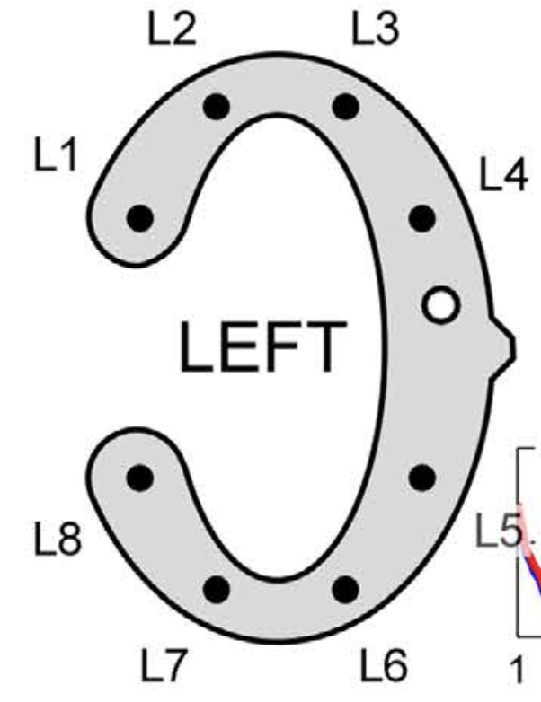
= Not available
= Available
Fp1
Nasion
Fp2
Ground
Electrode
L2
L3
F7
F8
R2
R3
F3
Fz
F4
L1
L4
R1
R4
L4a
R4a
T3
C3
Cz
C4
T4
L4b
R4b
L8
L5
R8
R5
T5
P3
Pz
P4
T6
L7
L6
R7
R6
O1
O2
Inion

